Slide 1
CEVA_CV&CDNN
Qfdong

Slide 2
1.CEVA_CV
Arithmetic
Deploy on CEVA
2.CNN
Arithmetic
Optimization
3.Instruction set
Introduction

Slide 3
指令集
VDEINTERLEAVE
if (odd)
Z[i] = A[i*2+1]
else
Z[i] = A[i*2]
VDEINTERLEAVE3
D={A,B,C}
Z0[i] = D[i * 3];
Z1[i] = D[i * 3+1];
Z2[i] = D[i * 3+2];

Slide 4
CEVA_CV
Haar & adaboost
Haar分类器算法的要点如下：
① 使用Haar-like特征做检测。
② 使用积分图（Integral Image）对Haar-like特征求值进行加速。
③ 使用AdaBoost算法训练区分人脸和非人脸的强分类器。
④ 使用筛选式级联把强分类器级联到一起，提高准确率。

Slide 5


Haar-like feature and Integral Image
Original image
Integral Image
Facial Haar features
1 1 1
1 2 3
Weak classifier with high speed
1 1 1
2 4 6
1 1 1
3 6 9
Pass
Stores Pixel sum of Rect(from top-left corner to this point)
Need 4 corner values
20 x 20 sub-window
p1
p2
P1
P2
R1
p3
p4
P3
P4
Fail
Pixel_Sum(R1) =
P4 - P2 - P3 + P1 = 4
Calculate Haar-feature value:
Pixel_Sum(Rect_W) – Pixel_Sum(Rect_B)
Constant time Pixel_Sum calculation

Slide 6


Feature selection
A weak classifier h
f₁
f₂
f₁ > θ (a threshold) => Face!
f₂ ≤ θ (a threshold) => Not a Face!
1 if f_{i} > θ
h =
0 otherwise

Slide 7
Adaboost
将弱分类器级联起来，达到强分类器的效果
Idea AdaBoost
(Adaptive Boosting, R.Scharpire, Y.Freund, ICML, 1996)
Adaboost是一种迭代算法，其核心思想是针对同一个训练集训练不同的分类器（弱分类器），然后把这些弱分类器集合起来，构成一个更强的最终分类器（强分类器）。
Image 1: Stages of the cascade classifier

Slide 8
Feature selection
Idea: Combining several weak classifiers to generate a strong classifier
……
α₁
α₃
α₂
α_{T}
α₁h₁+ α₂h₂ + α₃h₃ + … + α_{T}h_{T}
><
T_{thresold}
~performance of the weak classifier on the training set
weak classifier (feature, threshold)
h₁ = 1 or 0
Notes:
feature: type, location, scale

Slide 9

Cascade decision process
Frontal-face has 2000 features
Divided into multiple stages
S1
2 features
pass
S2
5 features
pass
S3
16 features
pass
S22
212 features
pass
……
Face detected
Fail
Reject
Fail any stage will reject current sub-window
Choose threshold for low false negative rate
Fast classifiers early in cascade
Slow classifiers later, but most examples don’t get there

Slide 10
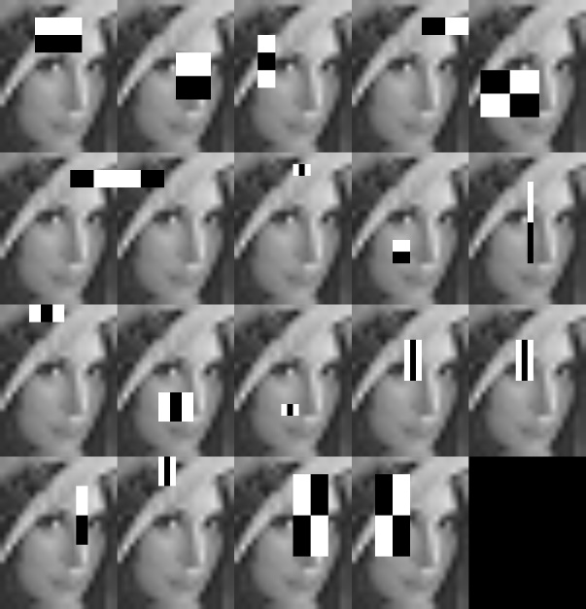
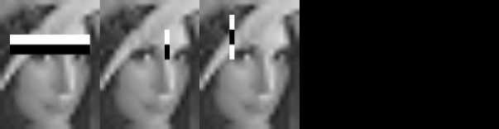
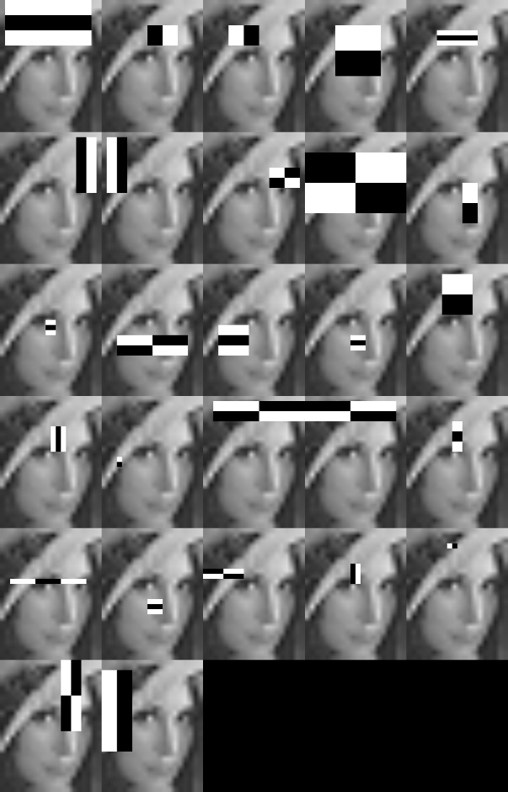
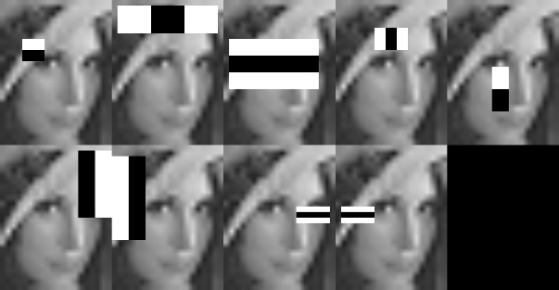
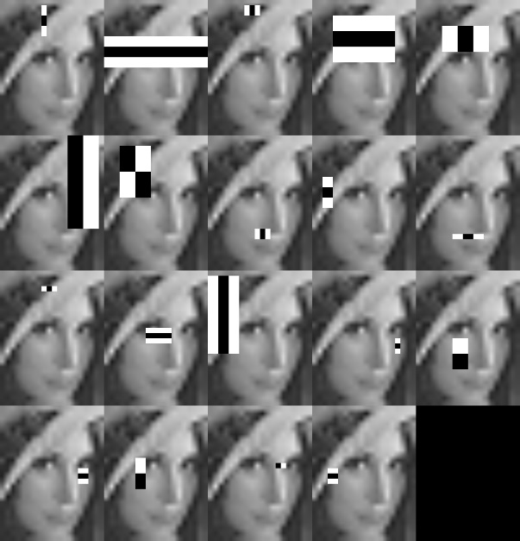
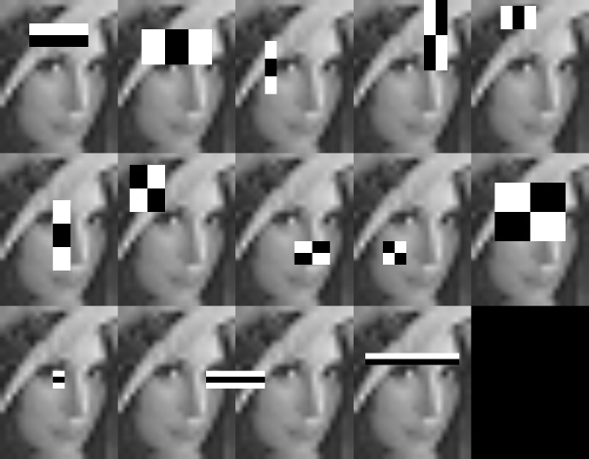
Visualization of first 6 stages
Like convolutional kernel in CNN

Slide 11
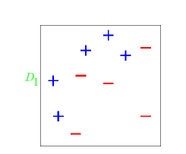
Adaboost 实例详解
下面我们举一个简单的例子来看看adaboost 的实现过程：
图中，“+”和“-”分别表示两种类别，在这个过程中，
我们使用水平或者垂直的直线作为分类器，来进行分类。

Slide 12
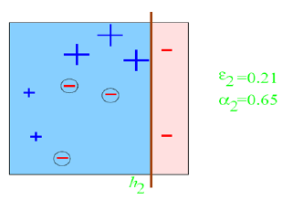
Adaboost 实例详解

Slide 13
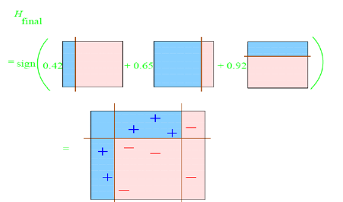
Adaboost 实例详解
每个区域是属于哪个属性，由这个区域所在分类器的权值综合决定。比如左下角的区域，属于蓝色分类区的权重为h1 中的0.42和h2 中的0.65，其和为1.07；属于淡红色分类区域的权重为h3 中的0.92；属于淡红色分类区的权重小于属于蓝色分类区的权值，因此左下角属于蓝色分类区。因此可以得到整合的结果如上图所示，从结果图中看，即使是简单的分类器，组合起来也能获得很好的分类效果。

Slide 14
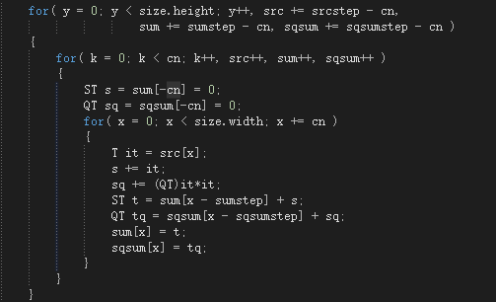
OpenCV=>CEVA_CV

Slide 15
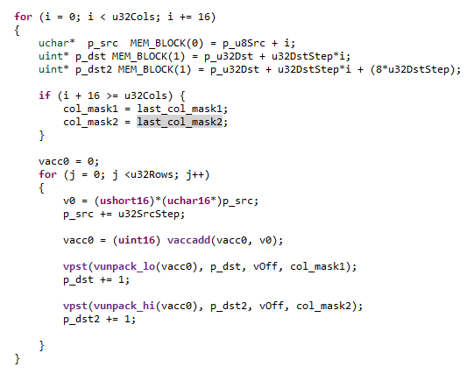
Integral Image Vectorized

Slide 16
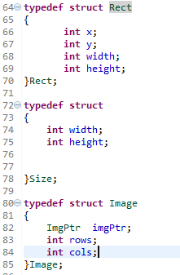
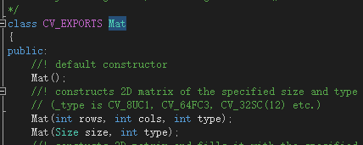
Deploy On CEVA
1.OpenCV结构=>普通C++结构
OpenCV的Mat数据格式十分复杂，很多函数，几乎用不到。需要简化数据结构
2.浮点转定点
在sliding window的时候，需要对窗口缩放。例如缩放因子是1.1，可以将其乘以32。
训练获得的xml文件，是一堆浮点数，可以乘以一个较大的数例如（1<<16）,转为short
3.Profile代码，找到最耗时部分，做向量化。

Slide 17
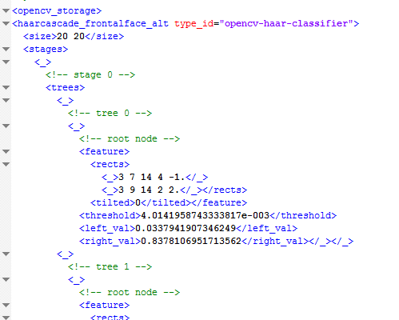
OpenCV=>CEVA_CV
训练过程是在PC机上，得到*.xml的文件
通过调用OpenCV的api，解析xml文件，将训练的数据存成数组。

Slide 18
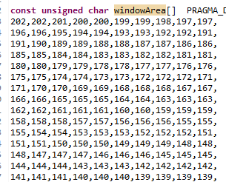

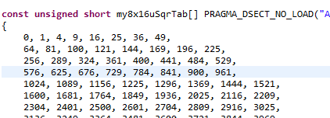

OpenCV=>CEVA_CV

Slide 19
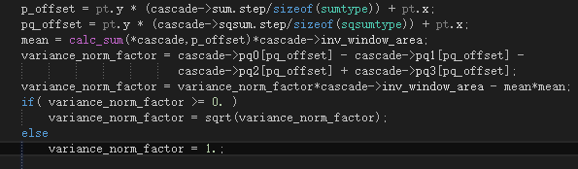

Slide 20
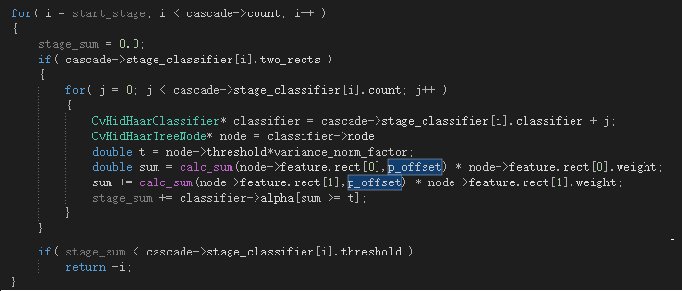
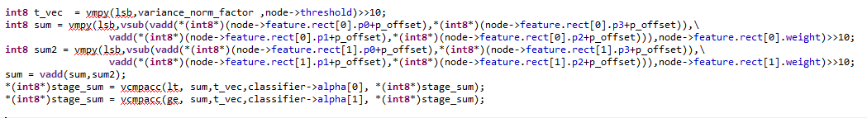

Slide 31
Drawbacks
1.积分图的结果如果用short类型表示，精度损失较大，用int则每个VPU仅可以处理8个int
2.对于未作vector的程序，如果当前窗口检测到人脸，则step为4，如果检测不到人脸，则step为2.而对于做了vector的程序，每8个窗口一组，不能如此动态的更改step的值。
3.对于未做vector的程序，由于是级联分类器，某个窗口经过若干个分类器，一旦判定为非人脸，则程序循环跳出，而对于做了vector的程序，8个窗口一起进入分类器，只有当8个窗口都判断为非人脸，程序才会跳出，很有可能8个窗口中，7个都是非人脸，仅有一个人脸，造成了计算的浪费

Slide 32
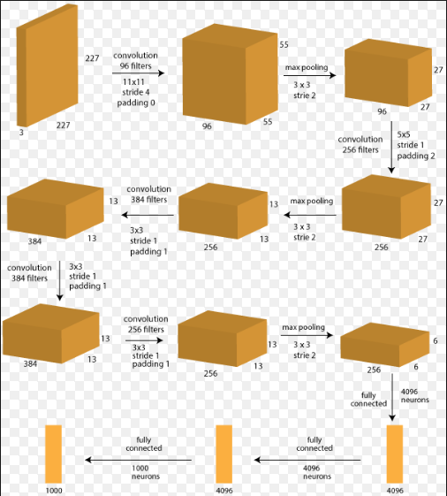
Introduction of Alexnet
1.Input Layer
2.Convolution Layer
3.Relu Layer
3.Normalization Layer
4.Pooling Layer
5.Full Connected Layer

Slide 33
1.Input Layer
Main Usage:
1.Sub the mean data so that the compute speed and accuracy can be improved
2.Bilinear the input image to 227*227

Slide 34
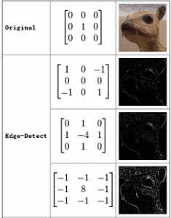
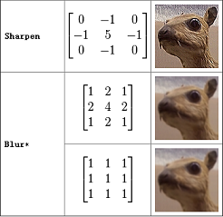
2.Convolution Layer
Why convolution effective?
How to compute convolution
(non-overlaping pooling)

Slide 35
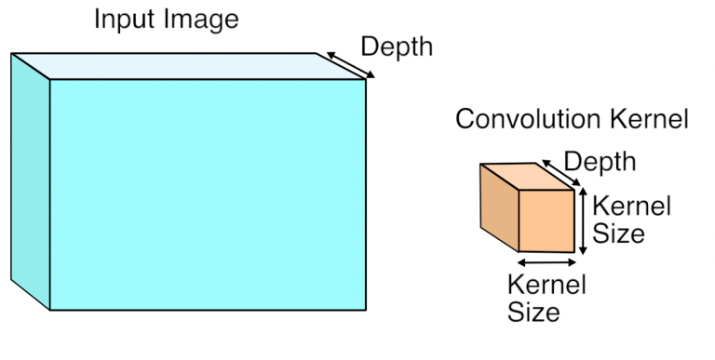
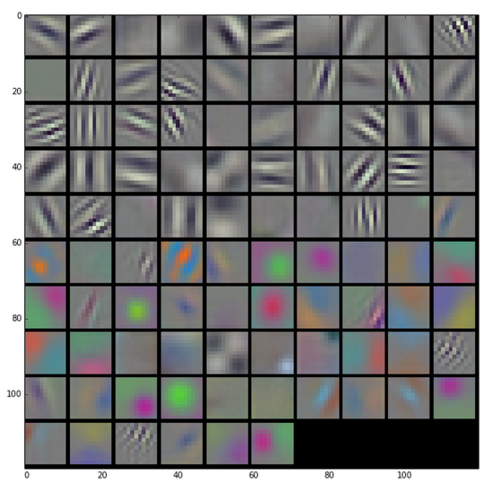
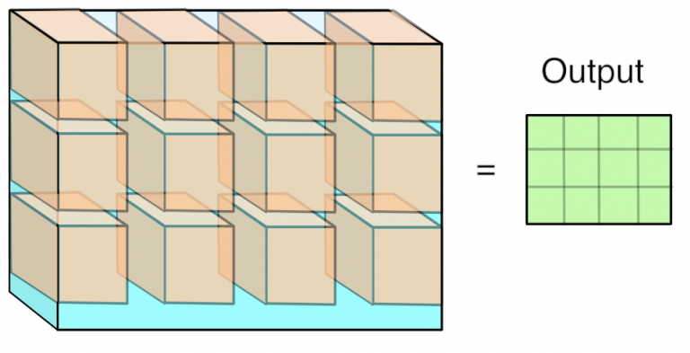

Slide 36
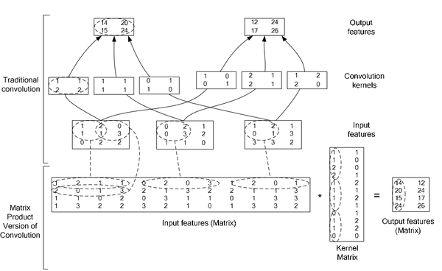
Computing in Caffe
Computing in Caffe

Slide 37
Computing in CDNN

Slide 38
Done by Generator In ConvLayer

Slide 39
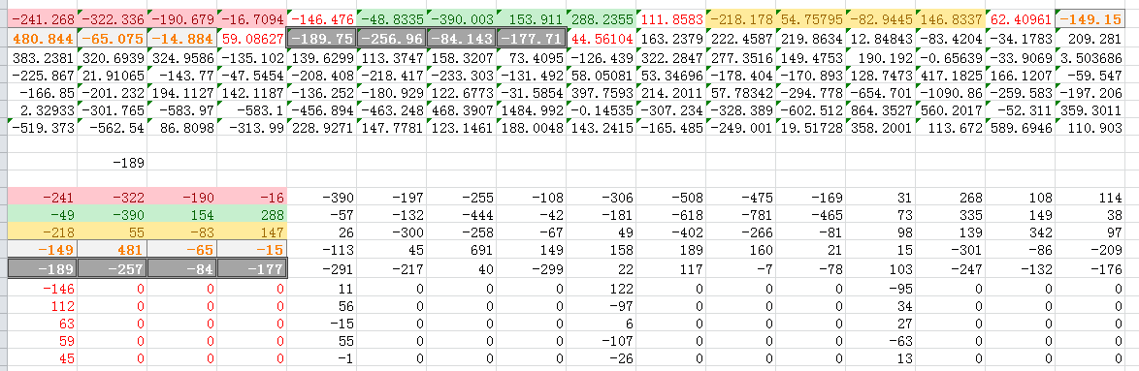

Slide 40
5x5

Slide 41
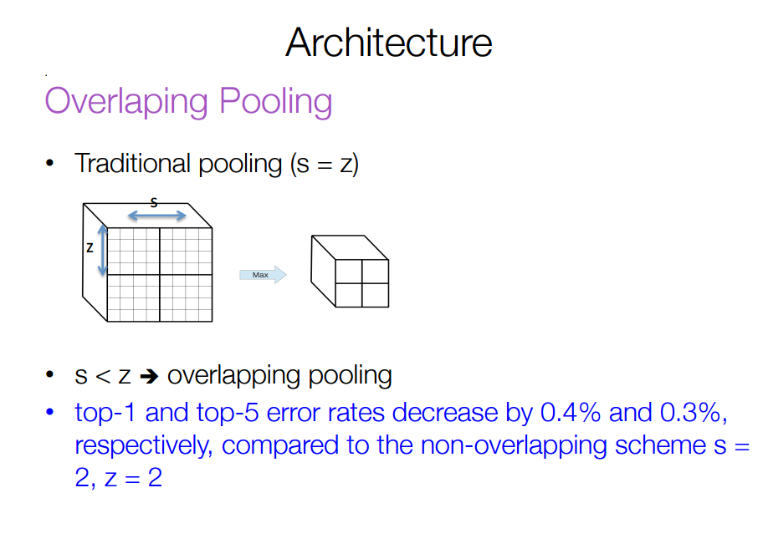

Slide 42
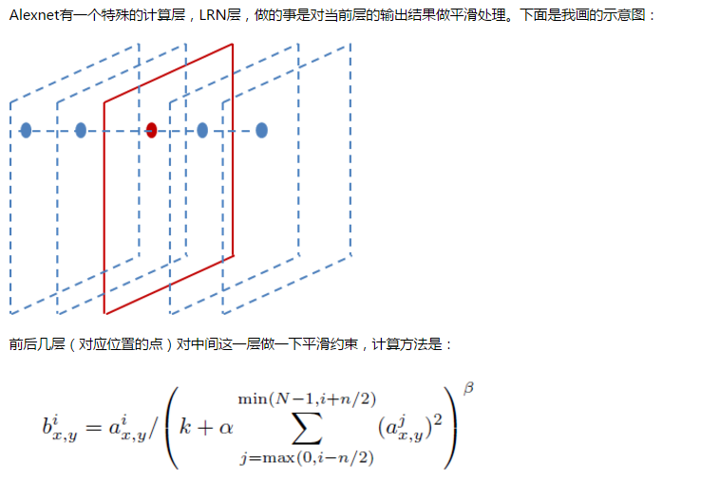
Local Response Normalization (LRN） Layer
In Alexnet, k=1,α=0.0001/5, n=5,β=0.75.a is the value in each layer and b is the normalized value.响应归一化将我们的top-1与top-5误差率分别减少了1.4%与1.2%

Slide 43
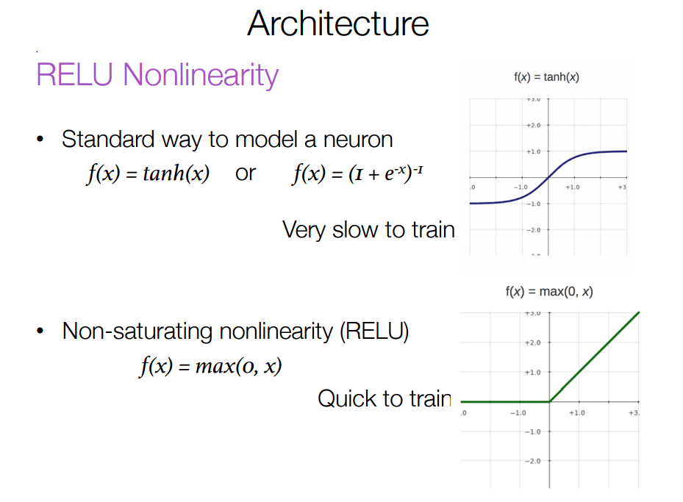

Slide 44
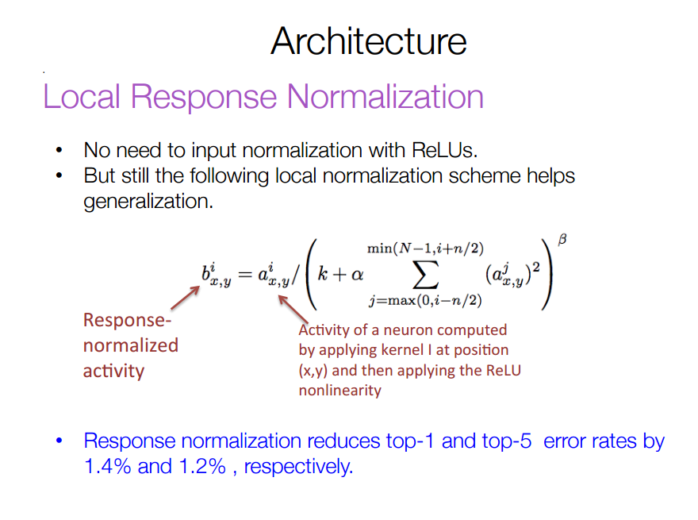

Slide 45
Weights Compression
What the Generator does?
Quantization
For Convolution Layer， the weights are represented in SHORT and for Full Connected Layer，the weights are represented in CHAR, which account for most of the model file.
Reorder
To adapt to the CEVA’s special customized instructions， after Quantization, the data is reordered to compute 4 kernels in parallel.
Layer | Model Size(MB)
Conv1 | float*96*3*11*11 | =0.1
Conv2 | float*256*48*5*5 | =1.2
Conv3 | float*384*256*3*3 | =3.4
Conv4 | float384*192*3*3 | =2.5
Conv5 | float*256*192*3*3 | =1.7
FC6 | float*4096*256*6*6 | =144(66%)
FC7 | float*4096*4096 | =64(29%)
Total |  | =217MB
Layer | Model Size(MB)
Conv1 | short*96*3*11*11 | =0.05
Conv2 | short*256*48*5*5 | =0.6
Conv3 | short*384*256*3*3 | =1.7
Conv4 | short*384*192*3*3 | =1.25
Conv5 | short*256*192*3*3 | =0.85
FC6 | char*4096*256*6*6 | =36(58%)
FC7 | char*4096*4096 | =16(26%)
Others | Bias + input layer | =5.95
Total |  | =62.4MB

Slide 46
CDNN
Num | Dim | Size | Layer
 | 612*612*3 | 1.07MB | Input image
0 | 227*227*3*2 | 301KB | Input layer
1 | 55*55*96*2 | 567KB | Conv1 layer
2 | 55*55*96*2 | 567KB | Norm1 layer
3 | 27*27*96*2 | 136KB | Pool1 layer
4 | 27*27*256*2 | 364KB | Conv2 layer
5 | 27*27*256*2 | 364KB | Norm2 layer
6 | 13*13*256*2 | 84.5KB | Pool2 layer
7 | 13*13*384*2 | 126KB | Conv3 layer
8 | 13*13*384*2 | 126KB | Conv4 Layer
9 | 13*13*256*2 | 84.5KB | Conv5 layer
10 | 6*6*256*2 | 18KB | Pool5 layer
11 | 4096*2 | 8KB | FC6
12 | 4096*2 | 8KB | RELU6
13 | 4096*2 | 8KB | Fc7
14 | 4096*2 | 8KB | RELU7
15 | 1000*2 | 1.95KB | FC8
16 | 1000*2 | 1.95KB | Prob
Total |  | 2.71MB

Slide 47
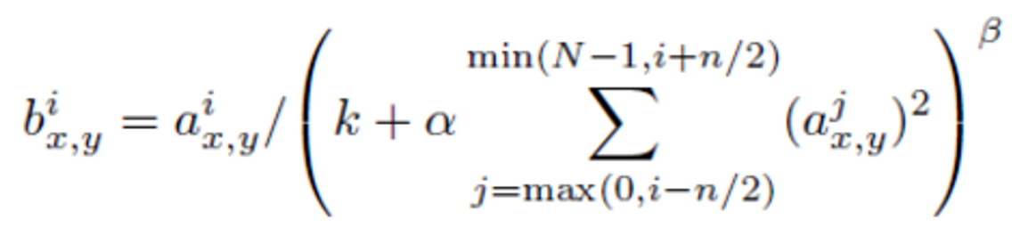
LRN computing vectorize
the approximate of f(x) = x^(-0.75) :
1.Taylor expansion
f(x)
= f(a)+f'(a)(x-a)
=a^(-0.75) - 0.75*a^(-1.75)(x-a)
=(-0.75)a^(-1.75)x+7/4*a^(-0.75)
=slope*x + bias
2.Based on the Taylor expansion, create a look up table

Slide 48
The process to compute x^(-0.75)
The process to compute x^(-0.75)
Index | 64 | 65 | 66 | 67 | 68 | 69 | 70 | 71 | 72 | 73 | 74
 | Index*(1<<9)
Vin | 32768 | 33280 | 33792 | 34304 | 34816 | 35328 | 35840 | 36352 | 36864 | 37376 | 37888
 | Vin/(32768.0)
Vin_float | 1 | 1.015625 | 1.03125 | 1.046875 | 1.0625 | 1.078125 | 1.09375 | 1.109375 | 1.125 | 1.140625 | 1.15625
 | （Vin_float[i]+Vin_float[i+1]）/2
Vin_mean | 1.007813 | 1.023438 | 1.039063 | 1.054688 | 1.070313 | 1.085938 | 1.101563 | 1.117188 | 1.132813 | 1.148438 | 1.164063
 | （-0.75）a^(-1.75)
Vslope | -0.73986 | -0.7202 | -0.70136 | -0.68327 | -0.66591 | -0.64924 | -0.63321 | -0.61779 | -0.60295 | -0.58867 | -0.57491
 | Vslope*(1<<15)
Vslope_q | -24243.6 | -23599.6 | -22982 | -22389.5 | -21820.6 | -21274.2 | -20748.9 | -20243.7 | -19757.6 | -19289.6 | -18838.8

Slide 49
The Optimization to compute x^(-0.75)
The built table is copied 16 times to store in DTCM, by vpld, we can compute 16 numbers of the x^(-0.75) at the same time

Slide 50
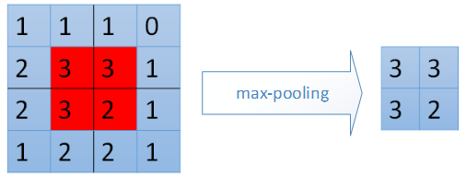
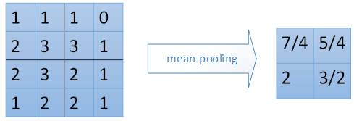
Pool Layer
max-pooling mean-pooling： ：

Slide 51
Compute in CDNN

Slide 52
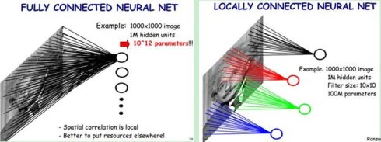
Full Connected Layer
Similar to convolution layer，来源于传统神经网络，参数太多，会overfitting，基本已经放弃

Slide 53
Computing in CDNN

Slide 54
Done by Generator in FC Layer

Slide 55
DropOut
这种技术叫做Dropout，它做的就是以0.5的概率，将每个隐层神经元的输出设置为零。以这种方式“dropped out”的神经元既不参与前向传播，也不参与反向传播。
所以每次输入一个样本，就相当于该神经网络就尝试了一个新的结构，但是所有这些结构之间共享权重。因为神经元不能依赖于其他特定神经元而存在，所以这种技术降低了神经元复杂的互适应关系。
正因如此，网络需要被迫学习更为鲁棒的特征，这些特征在结合其他神经元的一些不同随机子集时有用。在测试时，我们将所有神经元的输出都仅仅只乘以0.5，对于获取指数级dropout网络产生的预测分布的几何平均值，这是一个合理的近似方法。
只在训练的时候有用

Slide 56
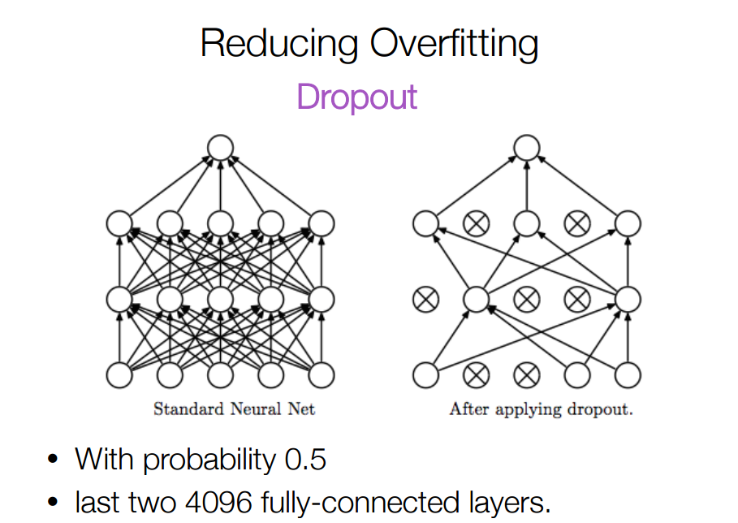

Slide 57
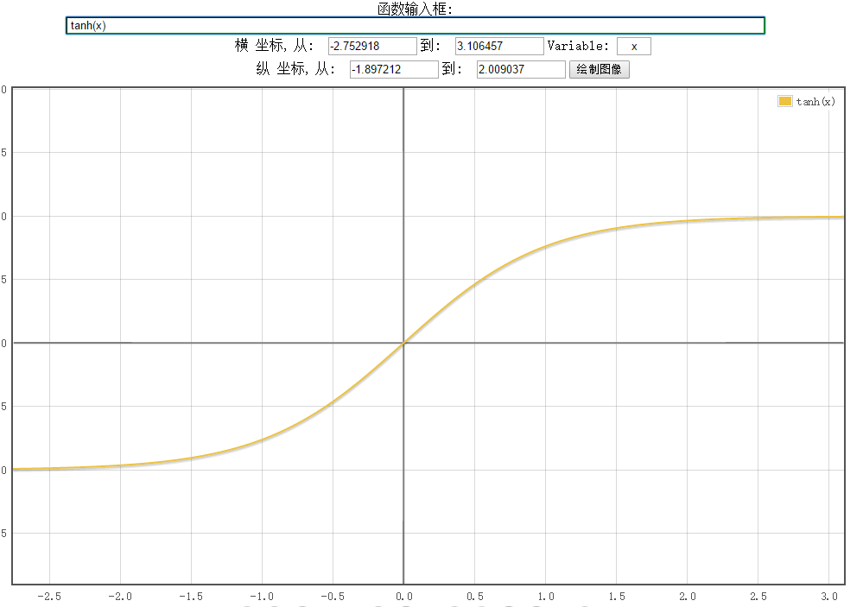
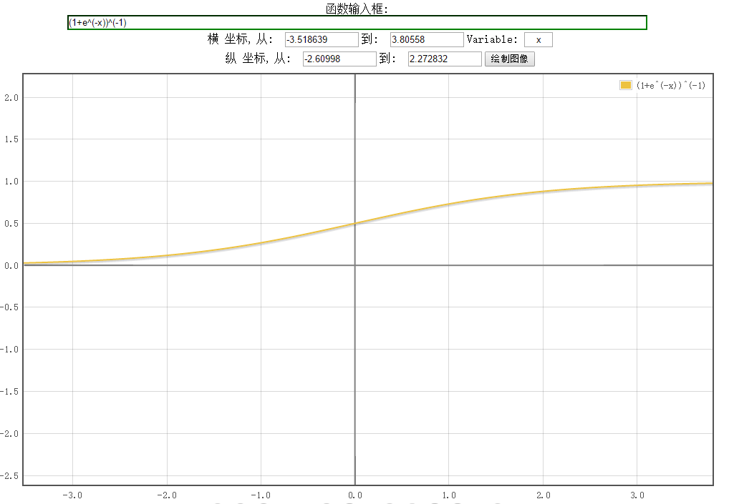

Slide 58
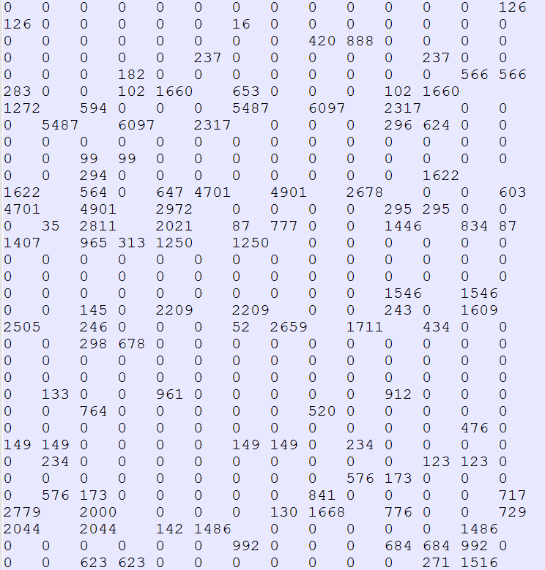
Bandwidth Reduction:
The input data of FC has large number of zero value, as show in the image
The zero values are about 50% of total input data

Slide 59
Cascade for Fast Detection
Stage 1
H₁(x) > t₁?
Yes
Stage 2
H₂(x) > t₂?
Stage N
H_{N}(x) > t_{N}?
Yes
Choose threshold for low false negative rate
Fast classifiers early in cascade
Slow classifiers later, but most examples don’t get there
…
Pass
No
No
No
Examples
Reject
Reject
Reject

Slide 60
Communication bottleneck
400-to-1 17-bit MUX:
2300 LUTs
12 MUXes: 27,600 LUTs
40% of Virtex5 110T(69,120)
……
400-to-1 mux
20 x 20 Integral image
Drawbacks:
Does not scale well for multiple classifiers
Wire congestion problem
A classifier port
General communication architecture

Slide 61
